Slide 1

AI CLUB CV BASICS
By: Kunal

Slide 2
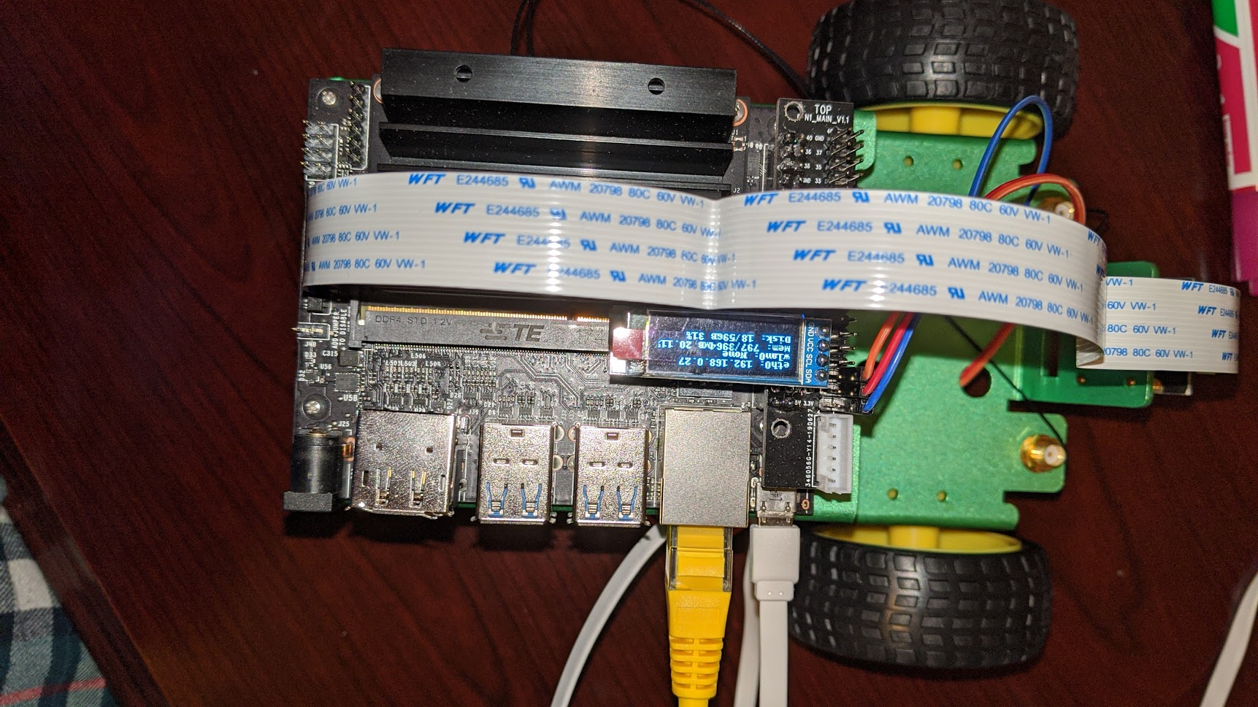
Plan for today
Presentation
Taking notes
Working on the projects
Drone
Robot

Slide 3
CV – Object Detection
Object Detection
Image Detection
Custom
Video Detection
Custom
Simple Single Image detection
Custom
Outline/Line detection
Object Tracking
Convert to frames

Slide 4
Code
#detections is an array
detector = ObjectDetection()
detector.setModelTypeAsYOLOv3()
detector.setModelPath( os.path.join(execution_path , "yolo.h5"))
detector.loadModel()
detections = detector.detectObjectsFromImage(input_image=os.path.join(execution_path , "image.jpg"), output_image_path=os.path.join(execution_path , "imagenew.jpg"), minimum_percentage_probability=30)

Slide 5
minimum_percentage_probability
When detecting a object, the model detection thousands of object but most of them are at 10% probability
Play with that number

Slide 6
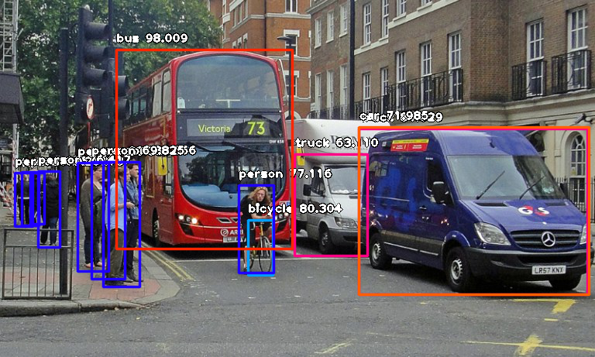
Image detection
Image detection
Simple Single Image detection
Detecting if Object is in the picture.
Control the variables(minimum probability)
Outline/Line detection
Detect the object
Track the outline of the object

Slide 7
How a CNN WORKS
In this dog picture, the model will detect patterns
[255,255,255] - RGB – BLACK
Group of black pixels → pattern → weight

Slide 8
Dues
Many people still havn’t paid their dues and we are checking on that. Please pay them asap

Slide 9
Robot(Quick Overview
Robot is the GPU.
Needs a screen connected to it
Needs access to WIFI to create IP address
Connect directly to school wifi via ethernet port
Open IP address on computer and run code directly.
Working on that today

Slide 10
Drone(Quick Overview)
var arDrone = require('ar-drone');
var client = arDrone.createClient();
client.createRepl();
/*
client.takeoff();
client.after(3000, function() {
this.stop();
this.land();
});
//This flies for 3 seconds and then turns of the motors, maybe crash?
*/
var pngStream = client.getPngStream();
Connect to the drone WIFI
Using javascript run the code wirelessly

Slide 11

Thank You
someone@example.com

